Slide 1

Investor Presentation
Friday, August 5, 2022

Slide 2
MISSION & VISION
Mission: Southwest Charlotte STEM Academy promotes high academic achievement by increasing student engagement through a workshop model that encourages and empowers students to take ownership of their learning.
Vision: Southwest Charlotte STEM Academy provides an educational environment of academic rigor and relevance that promotes high student achievement. SCSA's administrators and teachers lead this effort by creating a school environment whereby the faculty, families and community are committed to the mission. The overarching goal is to increase student engagement, via a workshop model of instructional delivery with a fully integrated STEM focus, that raises student academic achievement.

Slide 3
HISTORICAL, CURRENT AND PROJECTED ENROLLMENT
Grade | April 2022 | May 2022 | June 2022 | August (current) | Waitlist (current)
K | 89 | 89 | 109 | 118 | 17
1 | 84 | 84 | 96 | 98 | 26
2 | 91 | 91 | 103 | 104 | 21
3 | 82 | 82 | 100 | 102 | 28
4 | 84 | 84 | 103 | 103 | 23
5 | 68 | 68 | 102 | 106 | 18
6 | 97 | 97 | 119 | 125 | 16
7 | 94 | 94 | 105 | 111 | 49
8 | 93 | 93 | 100 | 100 | 39
9 | N/A | N/A | N/A | N/A | N/A
10 | N/A | N/A | N/A | N/A | N/A
11 | N/A | N/A | N/A | N/A | N/A
12 | N/A | N/A | N/A | N/A | N/A
TOTAL | 782 | 782 | 937 | 967 | 237

Slide 4
STUDENT DEMOGRAPHICS
Southwest Charlotte STEM |  | 2019-20 | 2020-21 | 2021-22
Asian |  | 6% | 8% | 8%
African American |  | 48% | 51% | 49%
Hispanic/Latino |  | 18% | 18% | 20%
White |  | 13% | 11% | 10%
Other |  | 2% | 12% | 13%
Economically Disadvantaged |  | 17% | 28% | 41%
Students with Disabilities |  | 10% | 11% | 12%
English Language Learners |  | 5% | 6% | 6%
Accelerated/Gifted |  | 6% | 4% | 3%

Slide 5

Our 22-23 Theme!

Slide 6
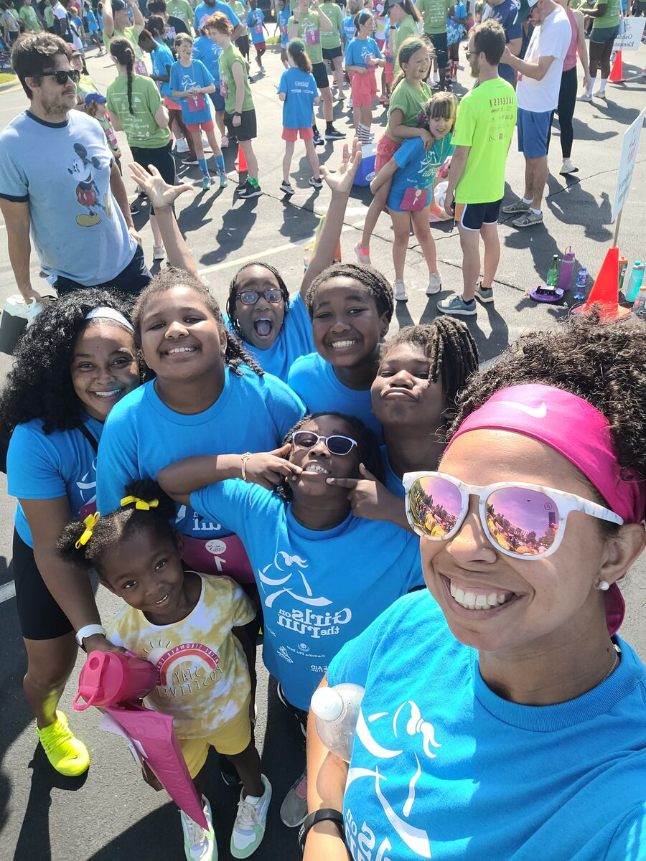
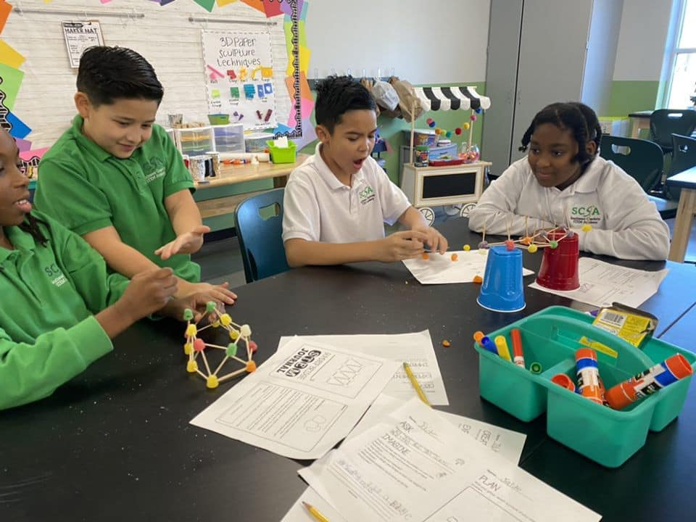
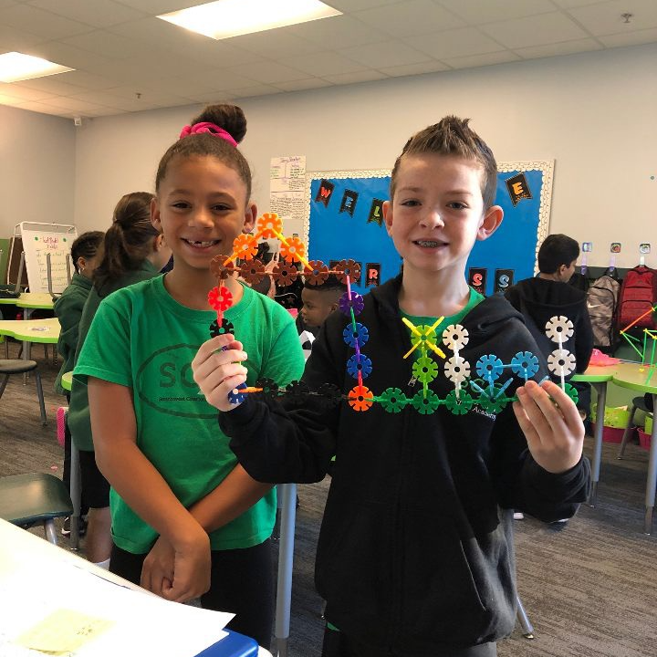

SCSA at a Glance!

Slide 7
SCSA Sports and Clubs
Clubs and Ogs
STEM and Robotics
Chess
Golf for Beginners
Harmony SEL Club
A Partnership with DigiBridge https://digi-bridge.org/
Dance
Girls on the Run
Athletics:
With the addition of an Athletic Director, SCSA will now provide a comprehensive middle school sports program that includes men’s and women’s teams in:
Volleyball
Girls and Boys Basketball
Cheer
Flag Football
Track

Slide 8
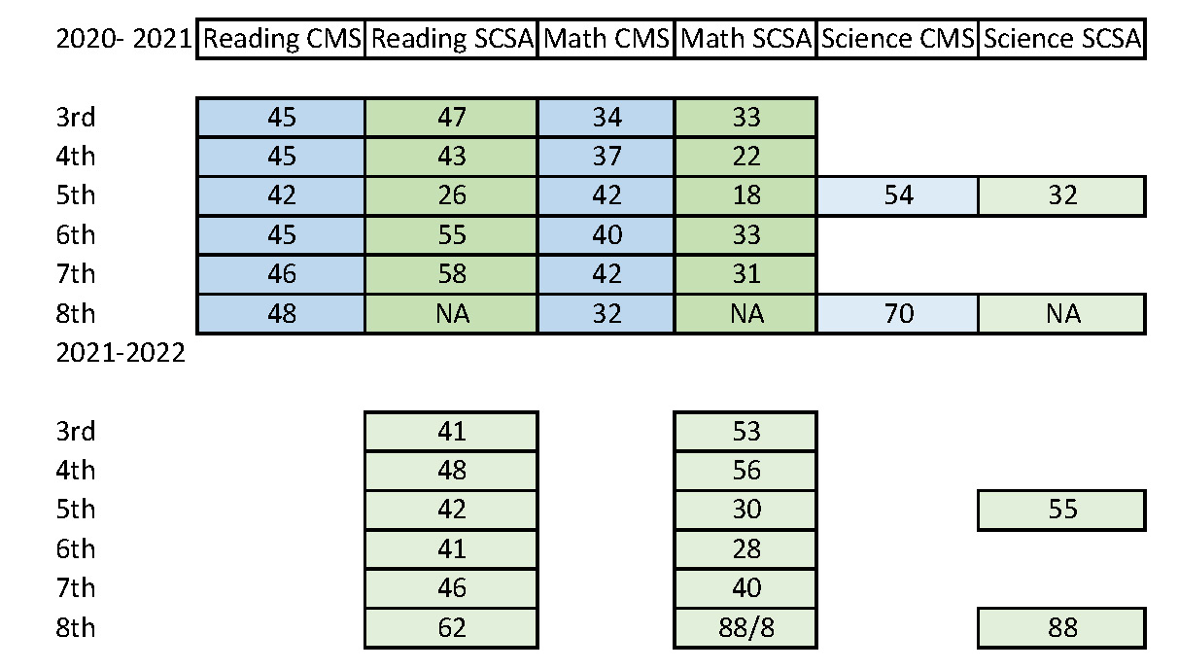
Academic Overview and Partial Comparison 20-22

Slide 9
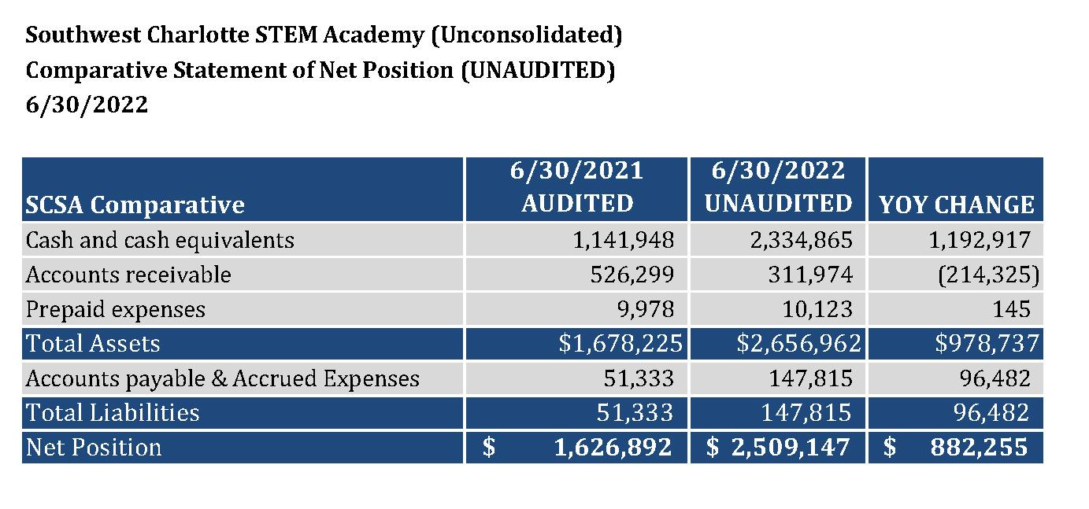

Slide 10
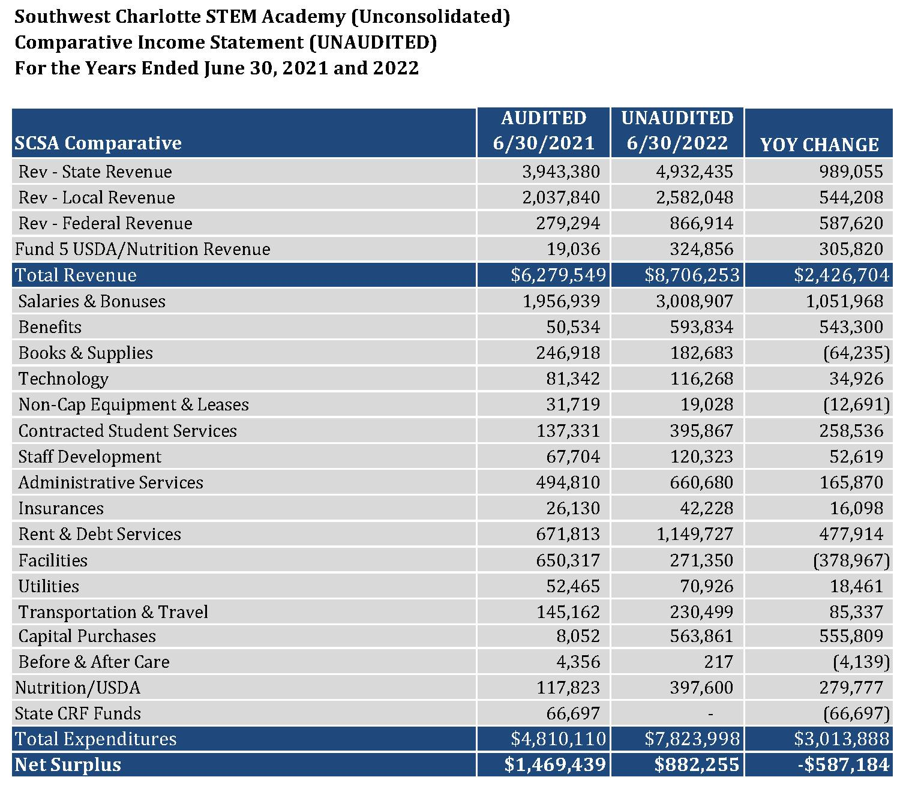

Slide 11
Bond Covenant Information
Days Cash on Hand Calculation as of 6/30/2022: 123
(2021 was 127)
Debt Service Coverage Ratio as of 6/30/2022: 1.38
(2021 was 2.09)

